Slide 1

Building Trust in Modern Computing Platforms
Aritra Dhar
ETH Zurich

Slide 2

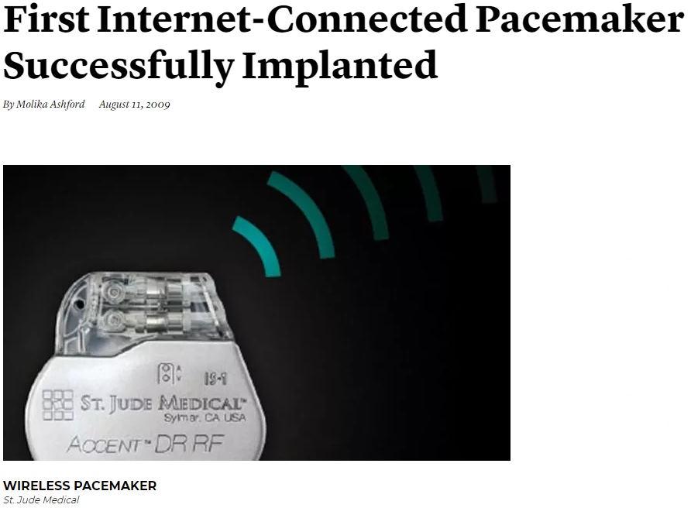


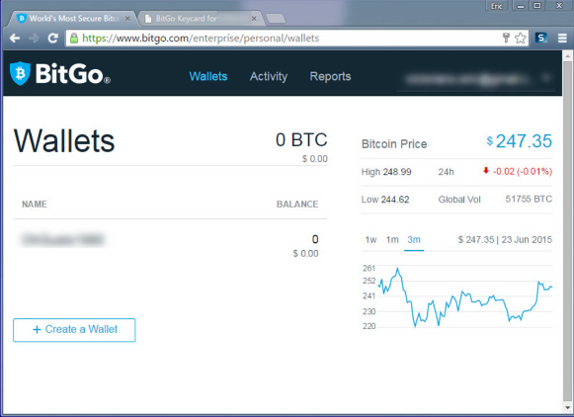
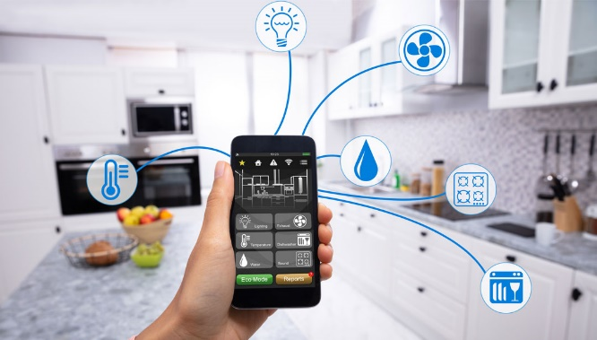
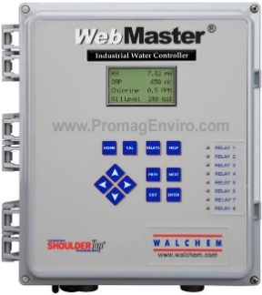
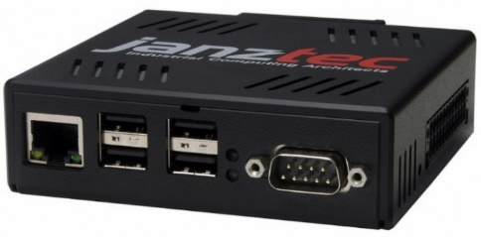
Remote safety/security-critical systems
Images are from janztec, wired, getty, controlbyweb
Notes:
First I will motivate you with some relevant examples that involves remote safety and security critical systems. Automation in industrial sector is getting more prevalent today and more and more of our critical infrastructure such a the electricity grid, gas pipelines, are monitored and actuated by these PLC or programmable logic controller. Compared to traditional PLCS, these are often web-enabled, i.e., they are networked attached and provide a web UI. The operators can remotely connect to the devices, monitor and actuate the equipments.
Other critical systems such as medical implants such as a pacemaker are becoming more and more smart so that a medical technicians can connect to them and monitor vitals or change some operational parameters. Smart homes are also another example where IoT devices report the current state of the home and user can operate them remotely. They also provide web or mobile enabled UI. Other, more traditional use cases could be financial transaction. And more and more people, specially during pandemic are opting for these web services.

Slide 3

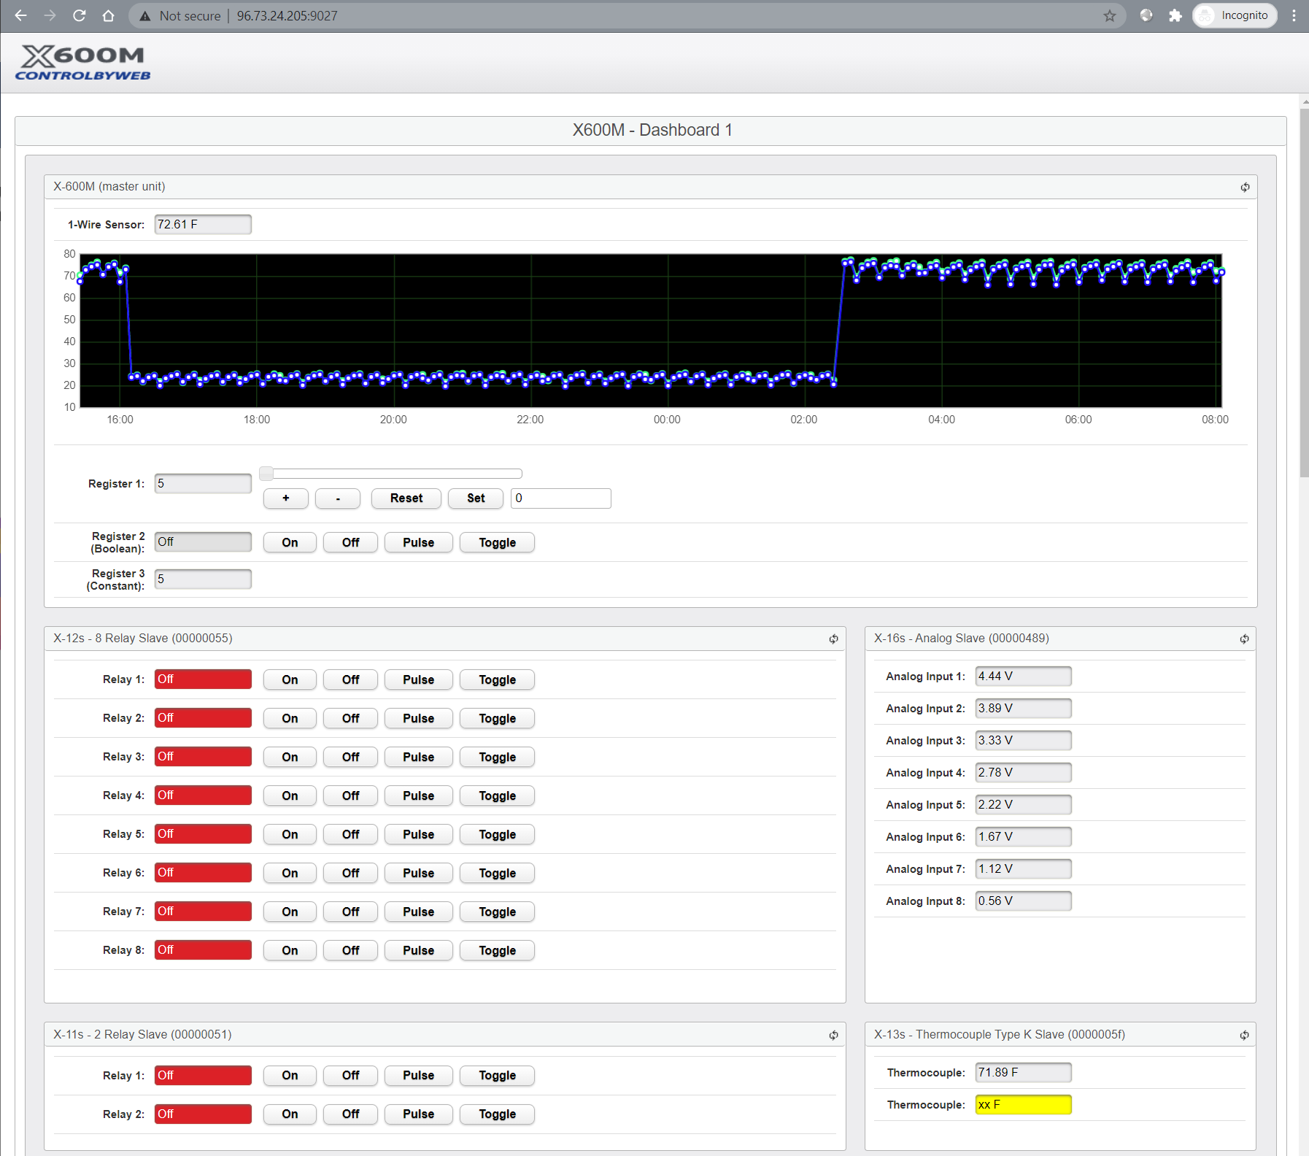
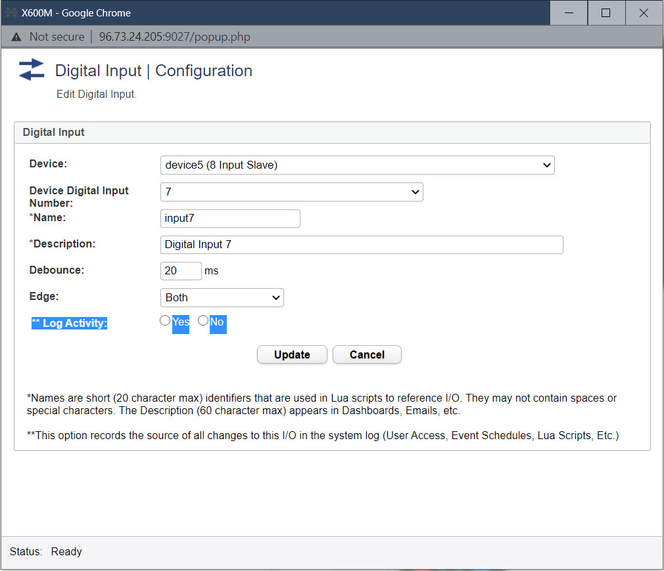
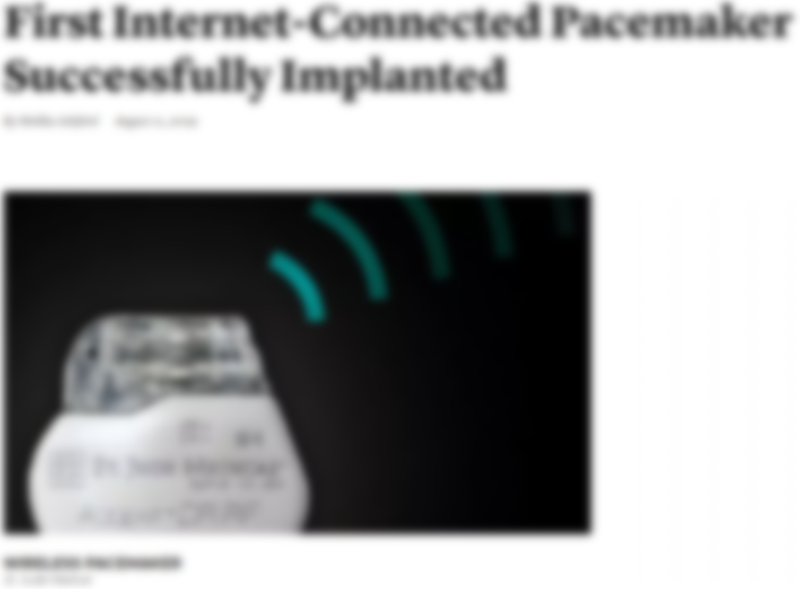








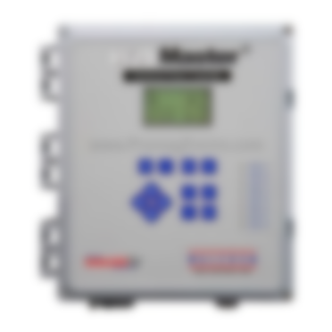



Remote safety/security-critical systems
Images are from janztec, wired, getty, controlbyweb

Slide 4







Large TCB $→$ Large Attack Surface
25.16M
20.92M
2M
36.68M
600K
CPU microcode
Device firmware
Device drivers

Slide 5
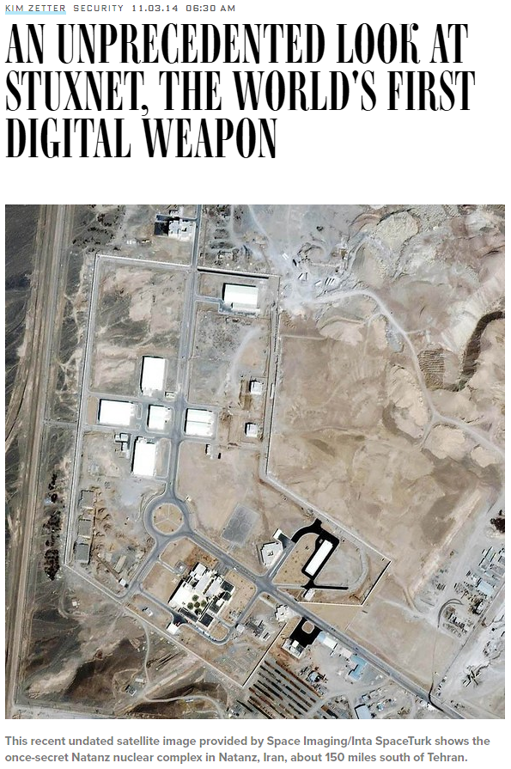
Attacks
Images are from wired, csmonitor, heimdalsecurity

Slide 6

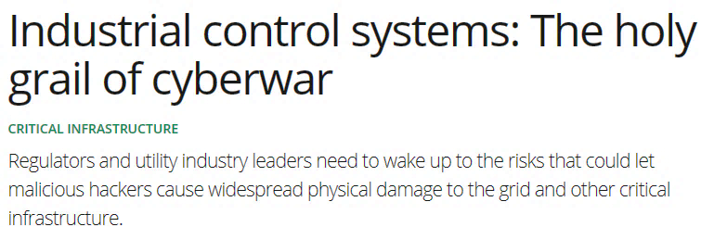
Attacks
Images are from wired, csmonitor, heimdalsecurity

Slide 7

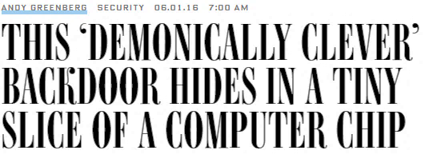
Attacks
Images are from wired, csmonitor, heimdalsecurity

Slide 8
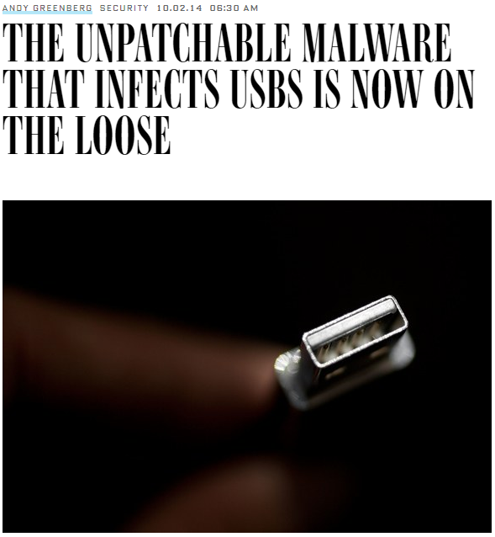

Attacks
Images are from wired, csmonitor, heimdalsecurity

Slide 9

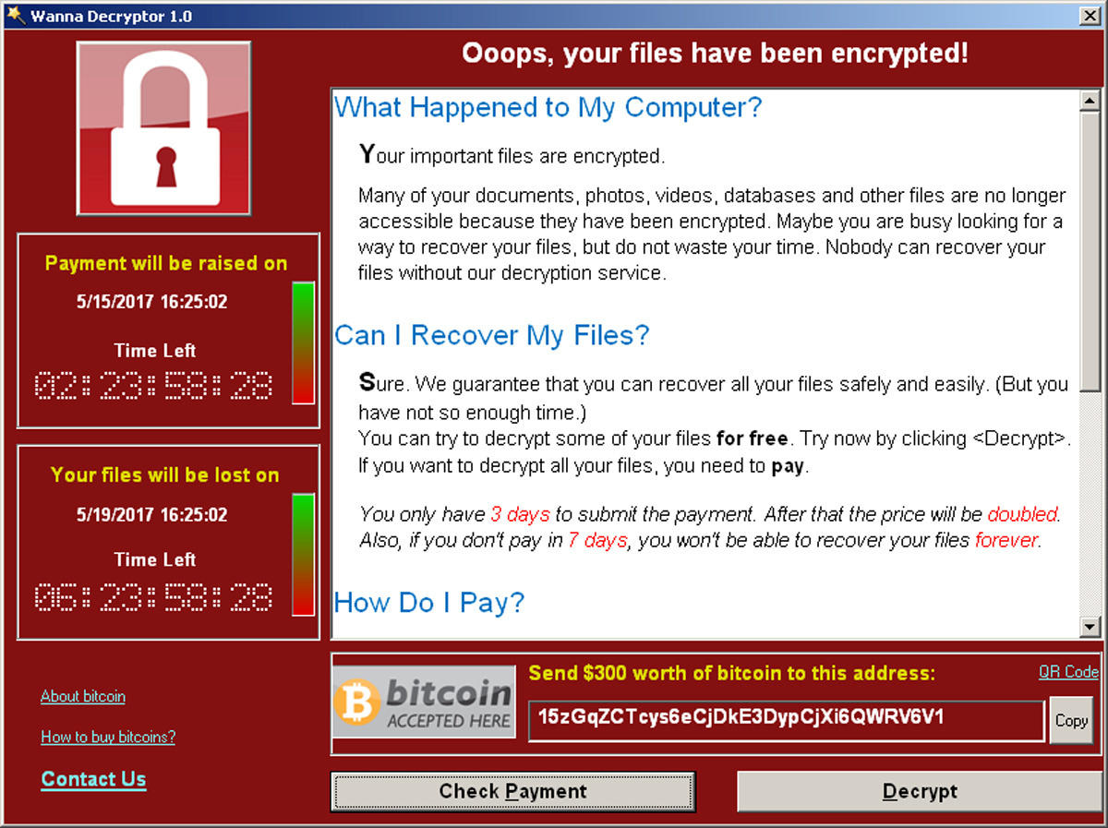
Attacks
Images are from wired, csmonitor, heimdalsecurity

Slide 10




Concrete Attack Scenario
Remote device
Heart beat
75
65
Insulin (U)
177
Basal rate (U/Hr)
0.025
Low limit (mg/dL)
60
High limit (mg/dL)
105
Program
Cancel
Aritra Dhar

Slide 11






Remote Trusted path
User
IO devices
Host
Remote System

Slide 12






Trusted Execution Environment (TEE)
TCB
App
App
App
App
App
Enclave
Operating System
Operating System
Dev
DRAM
CPU
Dev
DRAM
CPU
TCB
TCB
Traditional platforms
Intel SGX
OS still manages devices
Static HW TCB

Slide 13

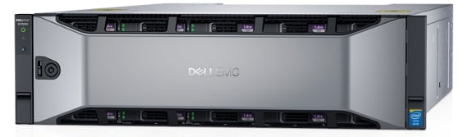
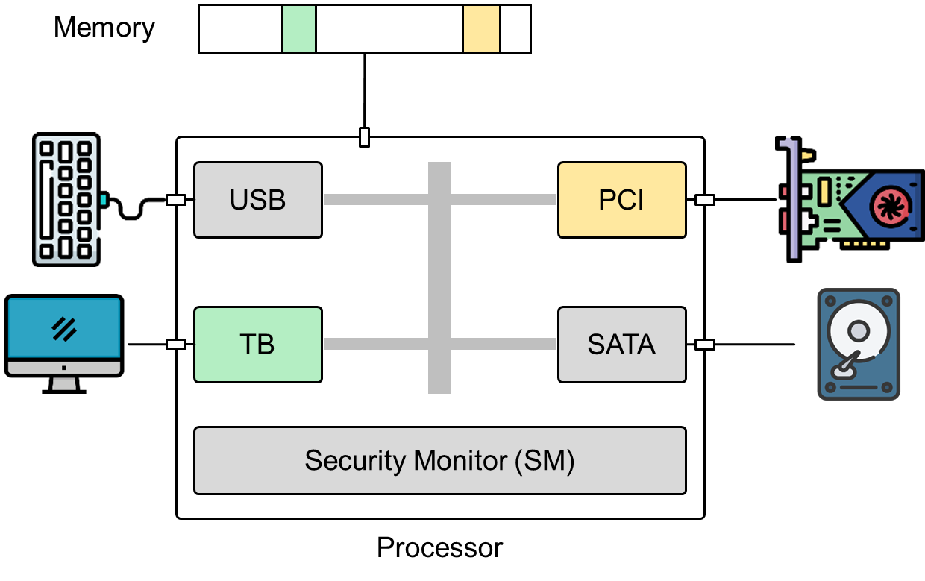

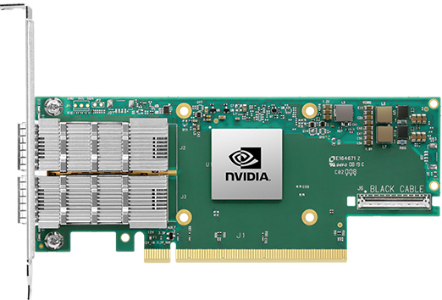
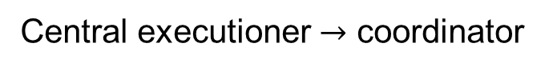
Disaggregated computing
Traditional CPU-centric model
Central executioner $→$ coordinator
Images are from nVidia, Dell, Mellanox official websites

Slide 14






My Contribution
IntegriKey (2017, eprint: 2017/1245)
ProtectION (NDSS 2020)
IntegriScreen (2018, arXiv:2011.13979)
Remote system
Remote trusted path application

Slide 15
My Contribution
IntegriKey (2017, eprint: 2017/1245)
ProtectION (NDSS 2020)
IntegriScreen (2018, arXiv:2011.13979)
Remote system
Remote trusted path application
ProximiTEE (CODASPY 2020)

Slide 16

My Contribution
IntegriKey (2017, eprint: 2017/1245)
ProtectION (NDSS 2020)
IntegriScreen (2018, arXiv:2011.13979)
Remote system
Remote trusted path application
Dedicated Security Chips in the Age of Secure Enclaves (IEEE S&P magazine 2020)
ProximiTEE (CODASPY 2020)

Slide 17



My Contribution
PIE (2020, arXiv:2010.10416)
IntegriKey (2017, eprint: 2017/1245)
ProtectION (NDSS 2020)
IntegriScreen (2018, arXiv:2011.13979)
Remote system
Remote trusted path application
Dedicated Security Chips in the Age of Secure Enclaves (IEEE S&P magazine 2020)
ProximiTEE (CODASPY 2020)

Slide 18
My Contribution
PIE (2020, arXiv:2010.10416)
IntegriKey (2017, eprint: 2017/1245)
ProtectION (NDSS 2020)
IntegriScreen (2018, arXiv:2011.13979)
Remote system
Remote trusted path application
Dedicated Security Chips in the Age of Secure Enclaves (IEEE S&P magazine 2020)
ProximiTEE (CODASPY 2020)

Slide 19
Today’s Talk
PIE (2020, arXiv:2010.10416)
IntegriKey (2017, eprint: 2017/1245)
ProtectION (NDSS 2020)
IntegriScreen (2018, arXiv:2011.13979)
Remote system
Remote trusted path application
Dedicated Security Chips in the Age of Secure Enclaves (IEEE S&P magazine 2020)
ProximiTEE (CODASPY 2020)

Slide 20
ProtectIOn setting
Remote trusted path application
Remote system

Slide 21







Solution 1: Transaction Confirmation Device
Remote device
Heart beat
75
Insulin (U)
177
Basal rate (U/Hr)
0.025
Low limit (mg/dL)
60
Android Protected Confirmation
You are going to program
Heart beat 75
Insulin 177U
Basal rate 0.025 U/Hr
Low level 60 mg/dL
High level 105 mg/dL
And more ……
High limit (mg/dL)
105
Program
Cancel

Slide 22



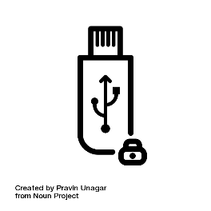
Solution 2: Input Signing
Remote device
Heart beat
75
Insulin (U)
177
Heart beat 75
Insulin 177U
Basal rate 0.025 U/Hr
Low level 60 mg/dL
High level 105 mg/dL
Basal rate (U/Hr)
0.025
Low limit (mg/dL)
60
Trusted embedded device
High limit (mg/dL)
105
Program
Cancel

Slide 23



Display manipulation attack
177
177
Insulin
17
7
1777
Insulin
177
User sees 177
Device records 1777
Host sends 1777

Slide 24
Observation 1
The lack of output integrity – the render of user inputs on the screen – compromises input integrity.

Slide 25

Solution 3: Overlay
Remote device
Remote device
Heart beat
Heart beat
75
Insulin (U)
Insulin (U)
177
Basal rate (U/Hr)
Basal rate (U/Hr)
0.025
Low limit (mg/dL)
Low limit (mg/dL)
60
High limit (mg/dL)
High limit (mg/dL)
105
Program
Cancel
Program
Cancel

Slide 26
Overlay: Output Manipulation
Remote device
Remote device
Heart beat
Insulin (U)
Insulin (U)
Heart rate
Basal rate (U/Hr)
Basal rate (U/Hr)
Low limit (mg/dL)
Low limit (mg/cc)
High limit (mg/dL)
High limit (mg/cc)
Program
Cancel
Program
Cancel

Slide 27

Overlay: Output Manipulation
Remote device
Remote device
Heart rate
75
Insulin (U)
177
Insulin (U)
177
Heart rate
75
Basal rate (U/Hr)
0.025
Basal rate (U/Hr)
0.025
Low limit (mg/dL)
60
Low limit (mg/cc)
6000
High limit (mg/dL)
105
High limit (mg/cc)
10500
Program
Cancel
Program
Cancel

Slide 28
Observation 2
If the protected output is provided out-of-context, users are more likely not to verify it.
Therefore input integrity can be violated.

Slide 29
Overlay: Early Form Submission Attack
Remote device
Heart beat
75
Textbox in focus
Insulin (U)
17
Basal rate (U/Hr)
0.025
Fidelius
Trusted overlay from FPGA
Low limit (mg/dL)
60
High limit (mg/dL)
105
OS triggers click
Program
Cancel

Slide 30
Observation 3
If not all the modalities of inputs are secured simultaneously,
none of them can be fully secured.

Slide 31






Requirements
The lack of output integrity – the render of user inputs on the screen – compromises input integrity.
Inter-dependency between Input and output

Slide 32
Requirements
If not all the modalities of inputs are secured simultaneously, none of them can be fully secured.
All modalities of input

Slide 33
Requirements
If the protected output is provided out-of-context, users are more likely not to verify it. Therefore input integrity can be violated.
Low cognitive load

Slide 34
Requirements
Low TCB and easy deploy

Slide 35
Requirements

Slide 36








ProtectIOn
Low TCB + fast deployment
Input modalities
IOHub

Slide 37

IO Integrity – Server-side Annotation
Remote device
Heart beat
<label for="insulin" secure="true">Insulin (U)</label> <input type="text" id="insulin" name="insulin" secure="true">
Insulin (U)
Basal rate (U/Hr)
Simultaneous IO
Low limit (mg/dL)
High limit (mg/dL)
Program
Cancel
ProtectIOn JS
<form action="/some_action", signature = "0x45AB…", id = "0x0ab..">

Slide 38


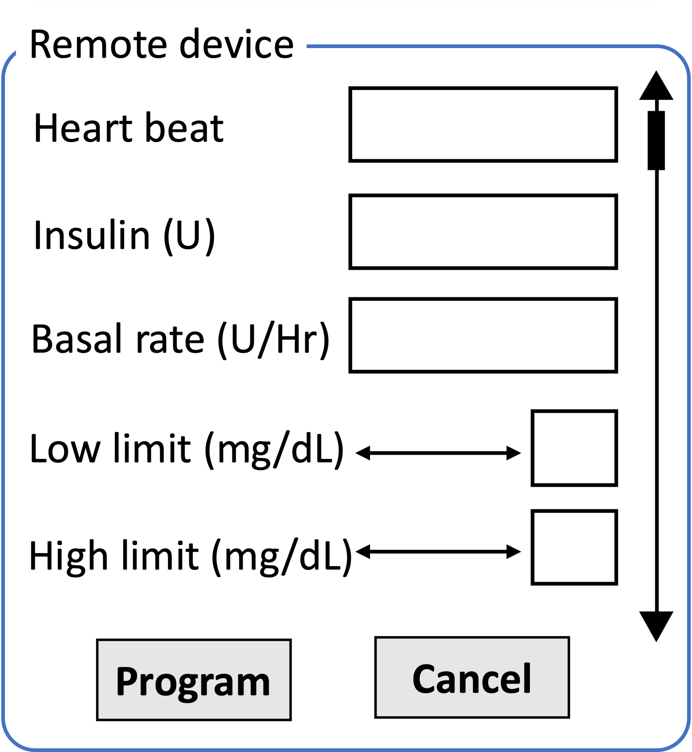

IO Integrity – HTML $→$ Specification
{
"formId": "form1",
"formName": "configure device",
"domain": "secure_site.io",
"size": "400*400",
"SAS": "5:LB",
"ui": [{
"id": "Insulin", "type": "textbox",
"label": “Insulin (U)",
"text":"",
"RE":(0-9)+},
{"id": "Heart rate",
…},
{"id":"b1",
"type": "button",
"label": "Program",
"trigger": "true"},
…],
"signature": "0x45AB...",
"id": "0x0ab.."}
<form action="/some_action", signature = "0x45AB…", id = "0x0ab..">
<label for="insulin" secure="true">Insulin
(U)</label> <input type="text" id="insulin"
name="insulin" secure="true"> …
</form>
ProtectIOn JS
Simultaneous IO
form1.bmp

Slide 39
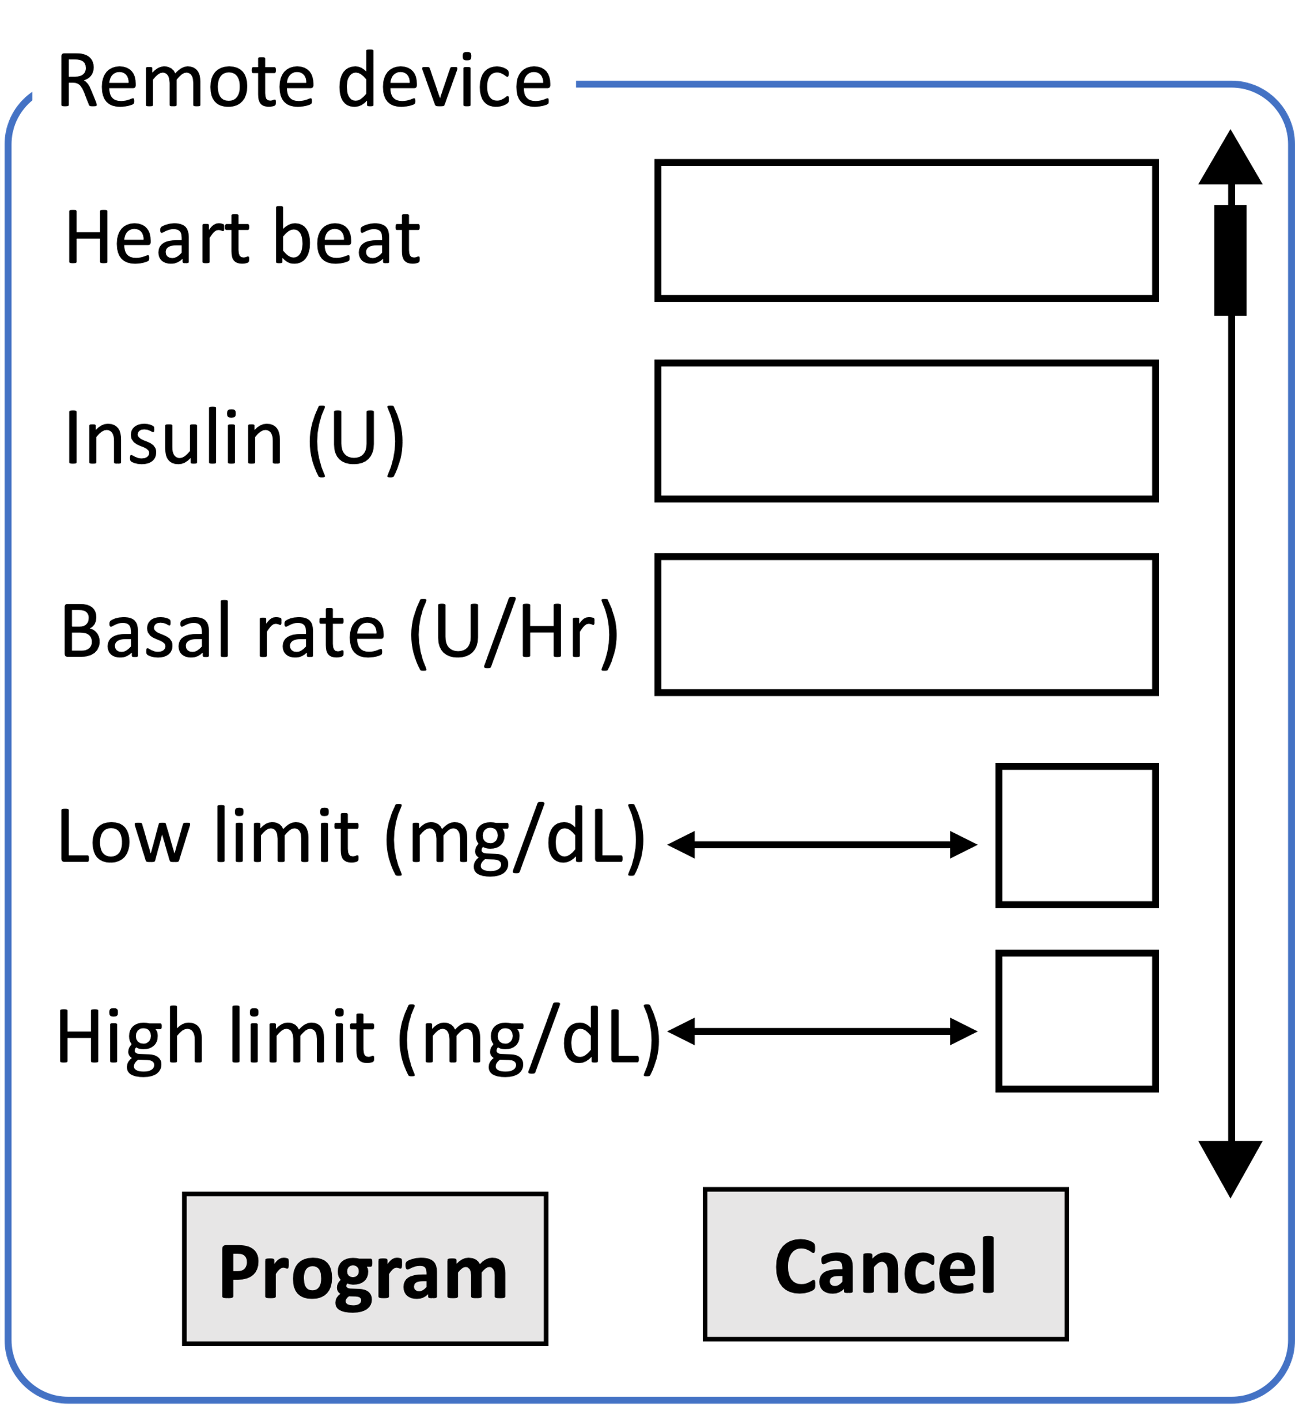
IO Integrity – UI $→$ QR Code
…
<form action="/some_action", signature = "0x45AB…", id = "0x0ab..">
<label for="insulin" secure="true">
Insulin(U)</label> <input type="text" id="insulin"
name="insulin" secure="true">
…
</form>
…
…
<img src=“form1.bmp”>
…
Simultaneous IO
ProtectIOn JS

Slide 40

IO Integrity – Overlay Generation
{
"formId": "form1",
"formName": "configure device",
"domain": "secure_site.io",
"size": "400*400",
"SAS": "5:LB",
"ui": [{
"id": "Insulin", "type": "textbox",
"label": “Insulin (U)",
"text":"",
"RE":(0-9)+},
{"id": "Heart rate",
…},
{"id":"b1",
"type": "button",
"label": "Program",
"trigger": "true"},
…],
"signature": "0x45AB...",
"id": "0x0ab.."}
Simultaneous IO

Slide 41



IO Integrity – Overlay Generation
Remote device
Verified UI from secure_site.io
Insulin (U)
Heart rate
Simultaneous IO
Basal rate (U/Hr)
Low limit (mg/cc)
High limit (mg/cc)
Program
Cancel

Slide 42


IO Integrity – Input
Remote device
Verified UI from secure_site.io
Insulin (U)
75
Heart rate
177
Simultaneous IO
Basal rate (U/Hr)
0.025
Low limit (mg/cc)
60
High limit (mg/cc)
105
Program
Cancel
ProtectIOn JS

Slide 43
Grabbing User Attention
Output Integrity: Low cognitive load
Several existing mechanisms
Low cognitive load
Put 1 in front of all inputs

Slide 44
Grabbing User Attention
Output Integrity: Low cognitive load
Several existing mechanisms
Lightbox
Low cognitive load
Put 1 in front of all inputs

Slide 45
Grabbing User Attention
Output Integrity: Low cognitive load
Several existing mechanisms
Lightbox
Highlight
Low cognitive load
Put 1 in front of all inputs

Slide 46
Grabbing User Attention
Output Integrity: Low cognitive load
Several existing mechanisms
Lightbox
Highlight
Freezing
Low cognitive load
Put 1 in front of all inputs

Slide 47
Grabbing User Attention
Output Integrity: Low cognitive load
Several existing mechanisms
Lightbox
Highlight
Freezing
Combination
Low cognitive load
Put 1 in front of all inputs

Slide 48
Grabbing User Attention
Output Integrity: Low cognitive load
Several existing mechanisms
Lightbox
Highlight
Freezing
Combination
How to determine when to engage?
Track pointer
Mouse movement on the overlay
Low cognitive load

Slide 49
ProtectIOn for Confidentiality

Slide 50
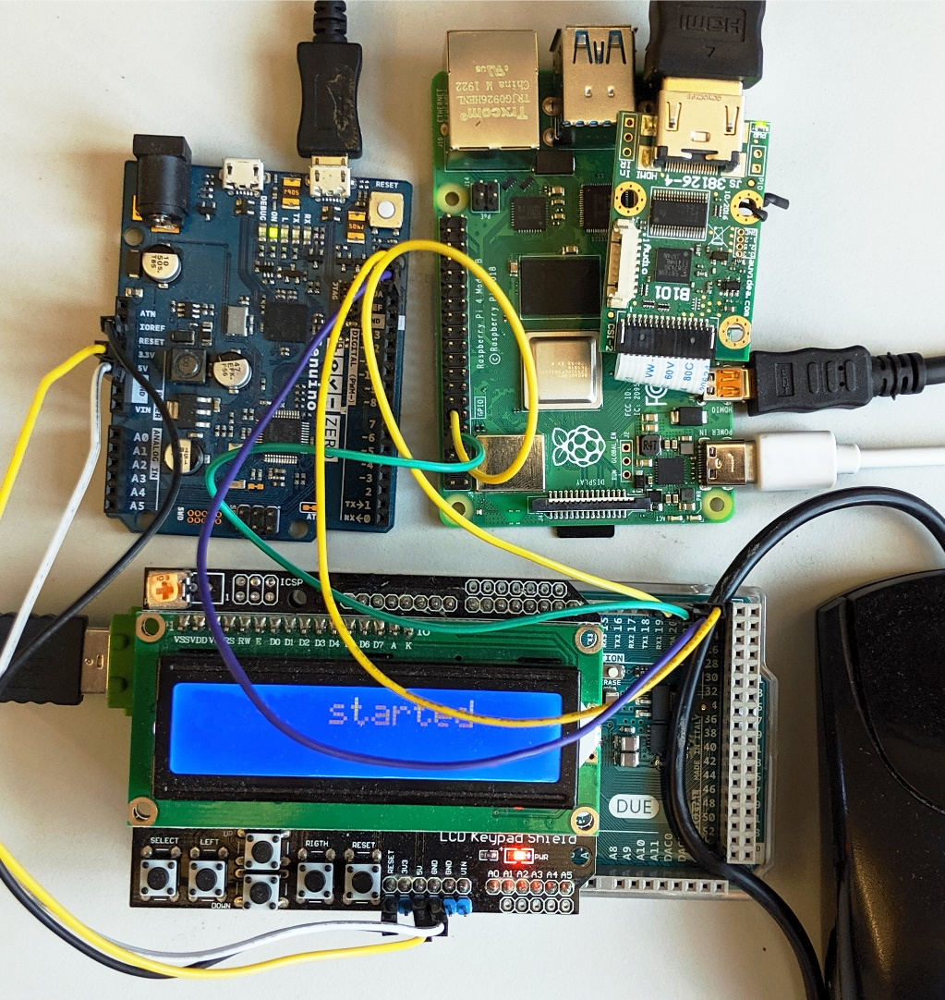

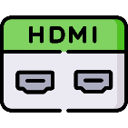







Prototype and TCB
Low TCB
Fast deployment
25.16M
20.92M
1.9K
2M
3.5K
71K
893
600K
121K
36.68M

Slide 51
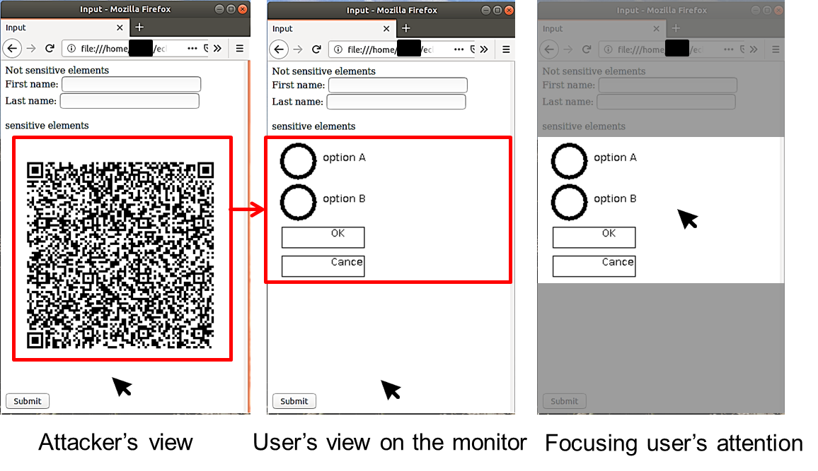

Performance
Display latency: 21.67 ms
~46 fps
Mouse latency: 250 $μs$
Keyboard latency: 170 $μs$
Pointer detection accuracy: 0.997

Slide 52
ProtectIOn $→$ProximiTEE
Remote trusted path application

Slide 53
ProtectIOn $→$ProximiTEE
Remote trusted path application
Identity of the platform

Slide 54









Motivation: Remote Attestation
Sensitive data
Enclave
A legitimate platform
A legitimate enclave
Platform PK
Report
Challenge
CPU
Verifier
Signed report

Slide 55





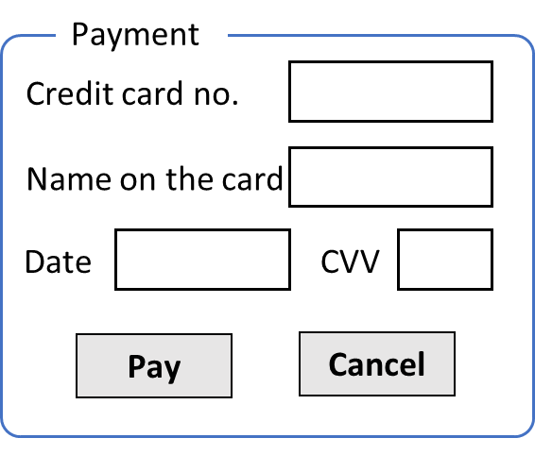

Relay Attacker
Challenge
App
Enclave
OS
Signed report
CPU
Verifier
Target platform
Relay challenge
Signed report
App
Enclave
OS
CPU
Assign secret
Attacker’s platform

Slide 56

Our Contribution: Auxiliary Device
App
Enclave
OS
CPU
ProximiKey
Verifier
Target platform
App
Enclave
OS
CPU
Attacker’s platform

Slide 57
ProximiTEE
App
Enclave
Establish secure channel
OS
CPU
ProximiKey
Verifier
Target platform
App
Enclave
OS
CPU
Attacker’s platform

Slide 58
ProximiTEE
App
Enclave
OS
CPU
ProximiKey
Target platform

Slide 59
ProximiTEE
App
Enclave
Initiate remote attestation
OS
Report + platform pk
CPU
ProximiKey
Target platform

Slide 60
ProximiTEE
App
Enclave
Secure channel
OS
CPU
ProximiKey
Target platform

Slide 61
ProximiTEE
Calculate latency
Determine proximity
App
Enclave
Challenge
OS
Response
CPU
ProximiKey
Target platform

Slide 62
ProximiTEE
Verifier
App
Enclave
OS
App
Enclave
CPU
ProximiKey
OS
Target platform
CPU
Attacker’s platform

Slide 63
ProximiTEE
Latency > threshold
Possible relay attack
App
Enclave
OS
CPU
Verifier
Target platform
App
Enclave
OS
CPU
Attacker’s platform

Slide 64



ProximiTEE
App
Enclave
Signed proximity result
OS
CPU
Verifier
Signed report
Target platform
A specific legitimate platform
App
Enclave
A legitimate enclave running on that platform
OS
CPU
Attacker’s platform

Slide 65
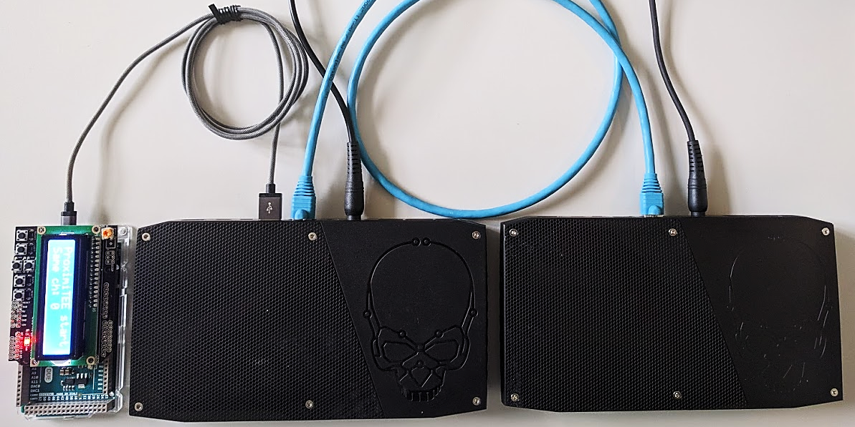
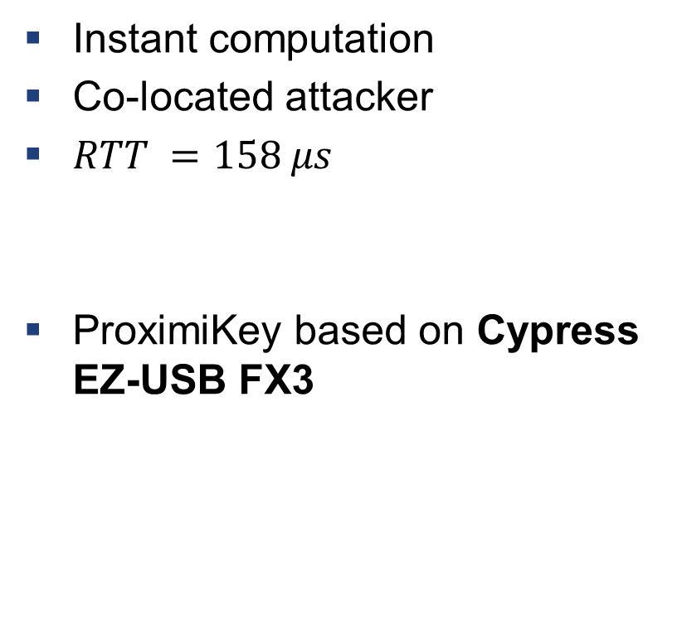
Setup: Simulating a Powerful Attacker
ProximiKey
USB 3.0 interface
1m Ethernet cable
Instant computation
Co-located attacker
$RTT =158 μs$
ProximiKey based on Cypress EZ-USB FX3
Target platform
Attacker’s platform

Slide 66
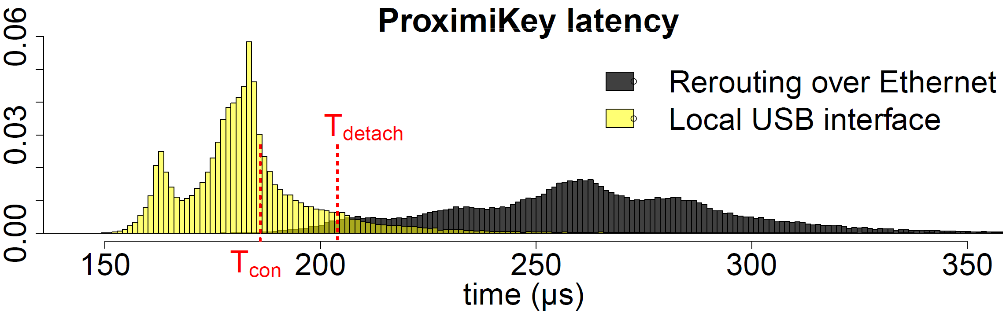
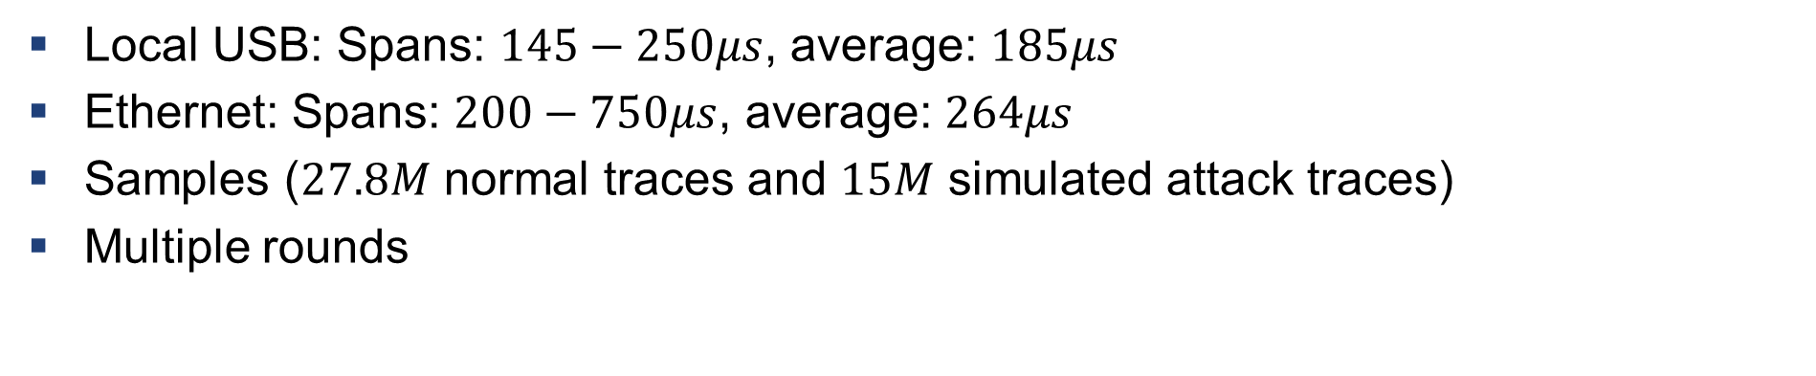
Main Experimental Result
Local USB: Spans: $145−250μs$, average: $185μs$
Ethernet: Spans: $200−750μs$, average: $264μs$
Samples ($27.8M$ normal traces and $15M$ simulated attack traces)
Multiple rounds

Slide 67
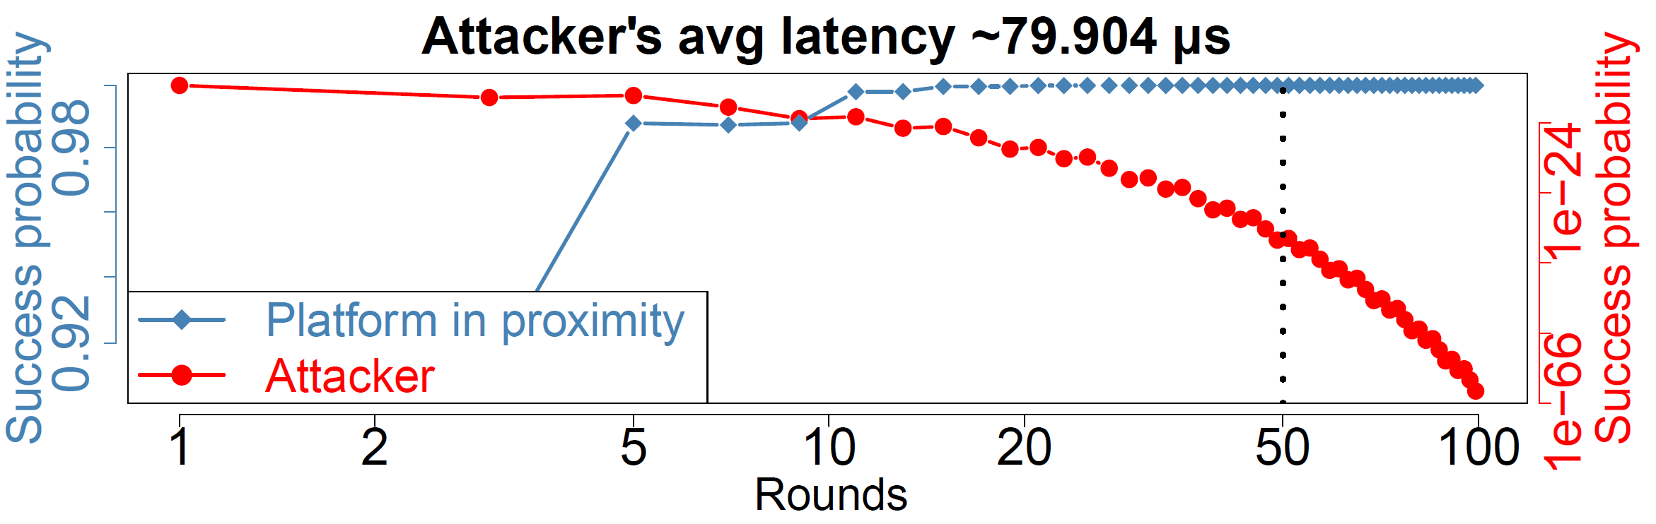

Proximity Verification Result
Robust: $P_{legit}=0.999999977$
Secure: $P_{adv}=3.55×{10}^{−34}$ for 50 rounds

Slide 68



Potential Use case: Trusted IO with Enclaves in Data Centre
I/O
I/O
User
User’s PC
Data center

Slide 69

Potential Use case: Setup of Permissioned Blockchain
Consensus node
Verifiers
Verifiers
Consensus node
Authority
Consensus node

Slide 70
ProtectIOn $→$ProximiTEE $→$ PIE
Remote trusted path application
Identity of the platform

Slide 71
ProtectIOn $→$ProximiTEE $→$ PIE
Remote trusted path application

Slide 72








Challenges
Secure communication
Remote attestation
Runtime attacks

Slide 73
Challenges
Secure communication
Remote attestation
Runtime attacks
Notes:
In traditional TEEs, the remote attestation is only limited to the enclaves that re running on the CPU cores. However, if we assume that the execution environments are distributed over multiple hardware component, this needs to be adopted.

Slide 74
Challenges
Secure communication
Remote attestation
Runtime attacks

Slide 75
Challenges
Secure communication
Remote attestation
Runtime attacks

Slide 76
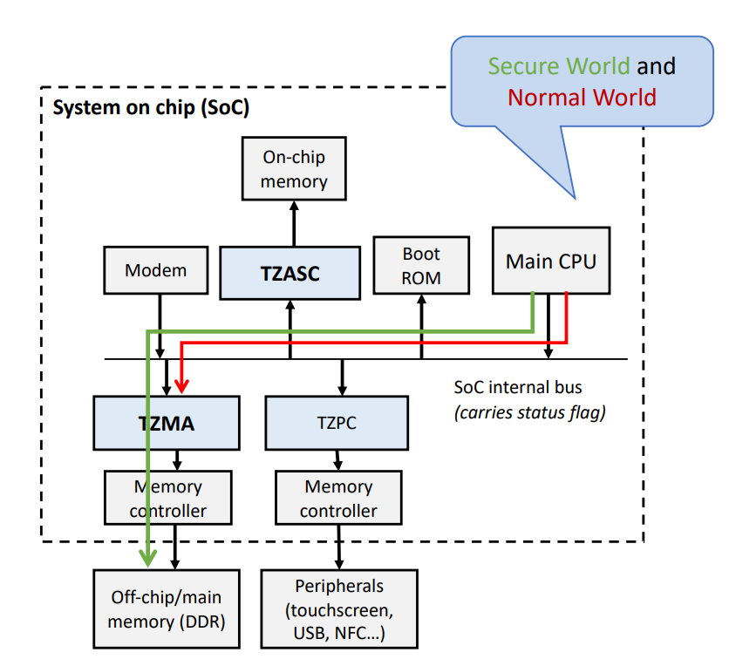
Can Existing TEEs Solve this Problem?
Can Existing TEEs Solve this Problem?
Secure world & non-secure world
App
App
Enclave
App
App
Enclave
U-mode
OS
Peripheral
OS
RT
S-mode
CPU
Peripheral
S-ROT
Security Monitor
M-mode
ARM TrustZone
Intel SGX
RISC-V KeyStone
Sanctuary
VButton
SGXIO
Graviton (SGX + nVidia GPU)
CURE

Slide 77
New Challenge
Secure communication
Remote attestation
Runtime attacks

Slide 78







New Challenge
TCB
Secure communication
Remote attestation
Runtime attacks
Least privilege

Slide 79

PIE: Platform Isolation Environment
Platform-wide enclave
Application
Driver
Device
Traditional software model:
PIE software model:
Application enclave
Controller enclave
Device

Slide 80



Communication in Platform Wide enclave
Shared memory
Firmware enclave
Controller enclave
Application enclave
HW-backed isolation
PMP entries:
EPC
EPC
0x00
0x0FF
Shared
Shared

Slide 81
Platform-awareness
Connect
EPC
App
App
Enclave
EPC
Peripheral
OS
EPC
RT
EPC
S-ROT
Security Monitor
Shared
Disconnect
EPC
EPC
Shared
Reset
Destroy internal states

Slide 82

Platform-wide Attestation
Needs
Application enclave report
DMA params
DMA params
Controller enclave 1 report
Controller enclave 2 report
AC policies
AC policies
report
report

Slide 83
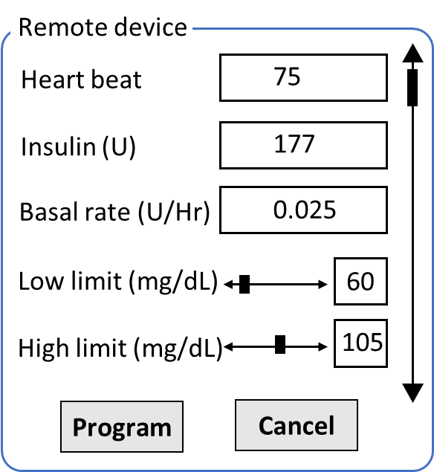




Platform-wide Attestation
Medical App
ML Application
1 MB
2 MB
56 MB
5 GB
KB controller enclave report
Pump controller enclave report
GPU controller enclave report
Exclusive
Exclusive
Shared
report
report
report

Slide 84
Summary of the properties
Platform-wide enclaves
Shared memory communication
Platform awareness
Platform-wide attestation

Slide 85
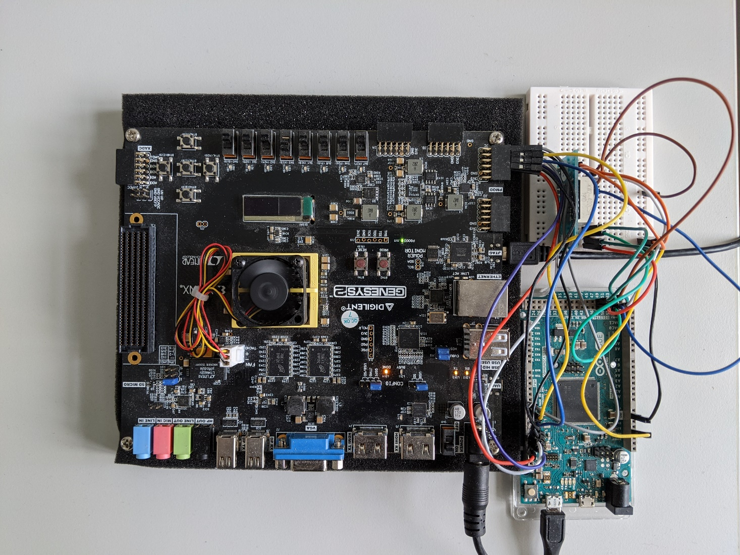
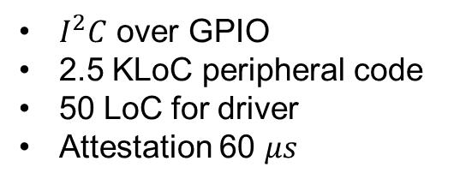
Prototype: simple IO peripherals
Peripheral emulation
FPGA running application class RISC-V core with PMP
PMOD peripheral
$I^{2}C$ over GPIO
2.5 KLoC peripheral code
50 LoC for driver
Attestation 60 $μs$

Slide 86
Prototype: Accelerator
Multi-tenant isolation
4096-core RISC-V* accelerator based on Snitch**
Addition of PMP
Small increase in the core size
750 MHz with 0 PMP
666 MHz with 4 PMP
* Florian Zaruba et. al. 2020. A 4096-core RISC-VChiplet Architecture for Ultra-efficient Floating-point Computing. In2020 IEEEHot Chips 32 Symposium (HCS). IEEE Computer Society, 1–24.
** F. Zaruba et. al. 2020.Snitch: A tinyPseudo Dual-Issue Processor for Area and Energy Efficient Executionof Floating-Point Intensive Workloads.IEEE Trans. Comput.(2020)

Slide 87
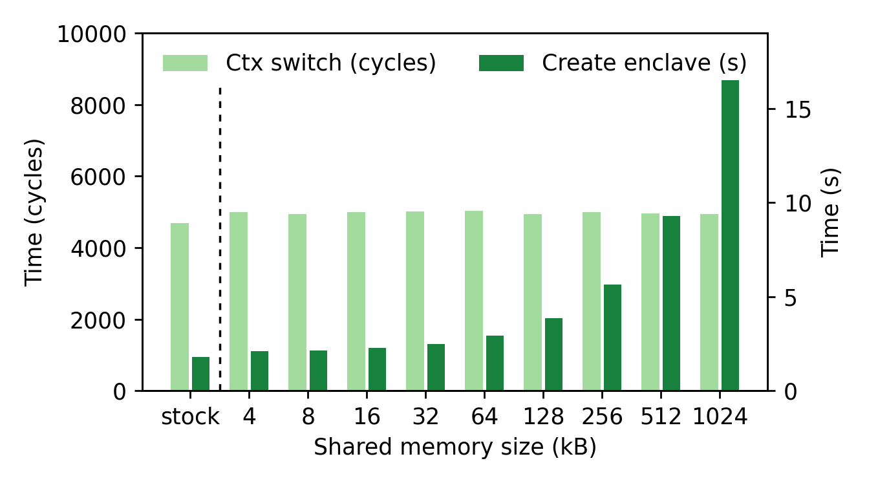
Context switch performance

Slide 88
Summary
PIE
ProtectIOn
Remote system
Remote trusted path application
ProximiTEE

Slide 89


Thank you! Questions?

Slide 90
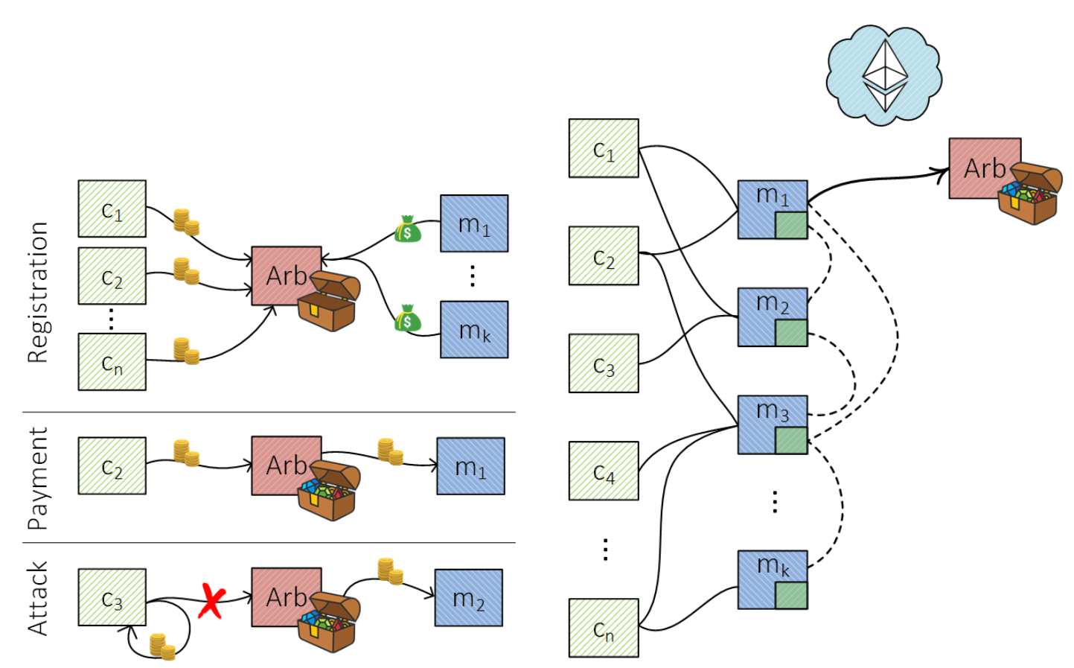
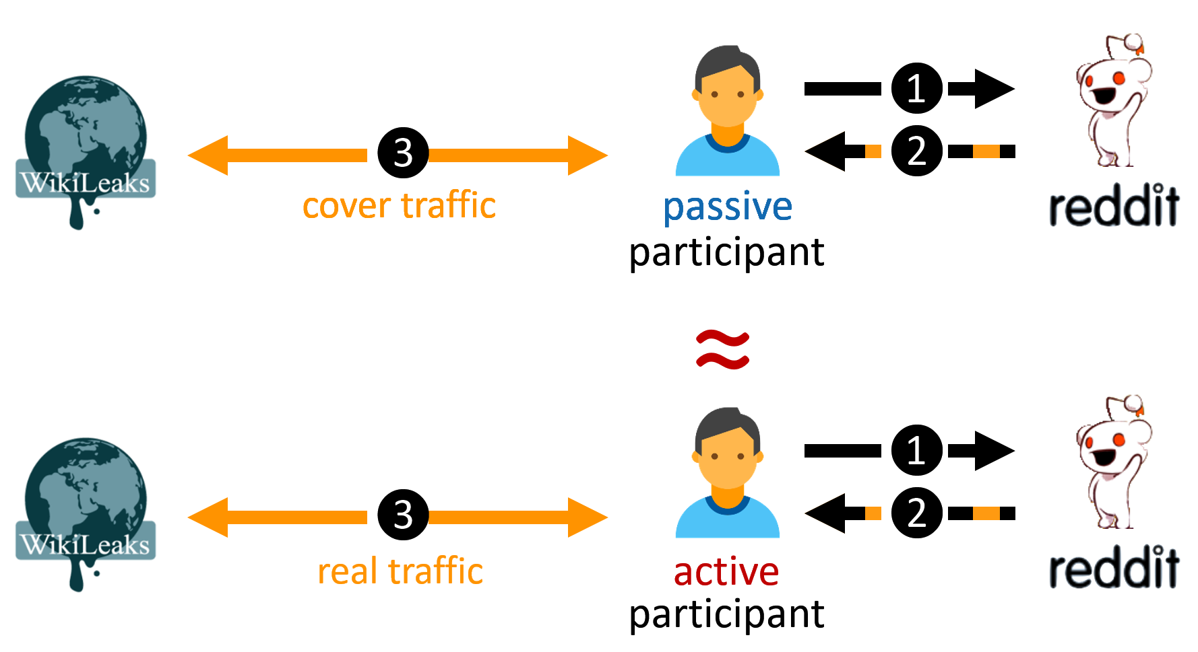
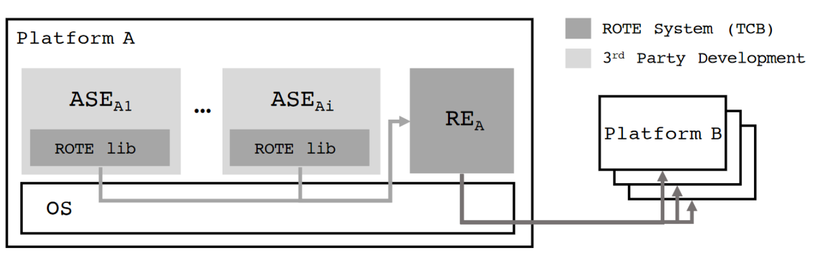
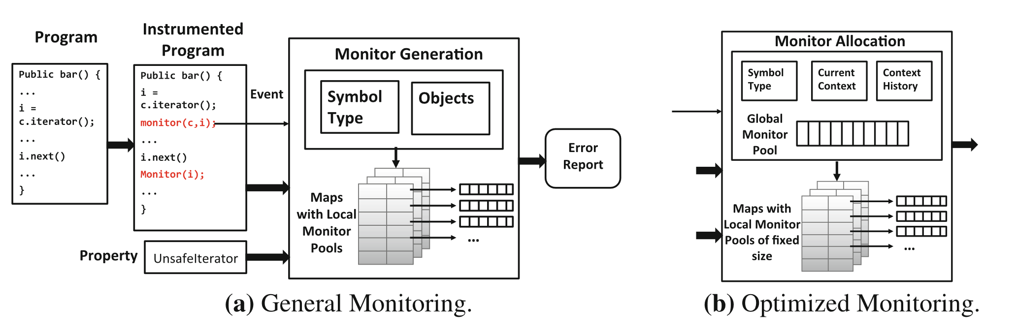
Other contributions
Fast off-chain payments
Snappy (NDSS 2020)
Anonymous communication
CoverUp (NSDI 2019)
Monitoring of type-state properties
Metis (RV 2018)
Rollback protection for SGX
ROTE (USENIX 2017)

Slide 91
Secure Communication
RISC-V PMP: Physical Memory Protection
OS
SM
RT+E
OS
Shared
Pmp0
000
Pmp1
000
Pmp2
111
Pmp2
000

Slide 92
Secure Communication
App
App
Enclave
SM
RT+E
OS
Shared
OS
RT
Pmp0
000
SM
Pmp1
000
Pmp2
111
Pmp2
111

Slide 93
Secure Communication
RISC-V PMP
App
App
Enclave
SM
RT+E
OS
Shared
OS
RT
Pmp0
000
SM
Pmp1
000
Pmp2
111
Pmp2
111

Slide 94
Secure Communication
RISC-V PMP
App
App
Enclave
SM
RT+E
OS
Shared
OS
RT
Pmp0
000
SM
Pmp1
111
Pmp2
000
Pmp2
111

Slide 95
Secure Communication
RISC-V PMP
App
App
Enclave
SM
RT+E
OS
Shared
OS
RT
Pmp0
000
SM
Pmp1
111
Pmp2
000
Pmp2
111

Slide 96
Secure Communication
RISC-V PMP: Physical Memory Protection
App
App
Enclave
SM
RT+E
OS
Shared
OS
RT
Pmp0
000
SM
Pmp1
111
Pmp2
000
Pmp2
111

Slide 97
Secure Communication
RISC-V PMP
Use PMP entries for shared buffers
App
App
Enclave
SM
RT+E
OS
Shared
OS
RT
Pmp0
000
SM
Pmp1
000
Pmp2
111
Pmp2
111

Slide 98


Traditional CPU-centric Model
Memory
USB
PCI
TB
SATA
Security Monitor (SM)
Processor

Slide 99
Platform-wide Attestation
Connect
Controller enclave 1
Send Cert
Connect
Controller enclave 2
Send Cert

Slide 100
Platform-wide Attestation
Connect
Controller enclave 1
Application enclave
Controller enclave 2
Connect

Slide 101
Platform-wide Attestation
Connect
Controller enclave 1
Application enclave
Controller enclave 2
Connect

Slide 102
Platform-wide Attestation
Controller enclave 1
Challenge
Application enclave
Controller enclave 2

Slide 103
Platform-wide Attestation
App enclave report
Controller enclave 1
Application enclave
Controller enclave 2
Controller enclave 1 ID
Controller enclave 2 ID

Slide 104
Platform-wide Attestation
App enclave report
Controller enclave 1
Application enclave
Controller enclave 2
Controller enclave 1 ID
Controller enclave 2 ID

Slide 105
Platform-wide Attestation
Challenge
Controller enclave 1
Application enclave
Controller enclave 2
Challenge

Slide 106
Platform-wide Attestation
Controller enclave 1 report + report
Controller enclave 1
Application enclave
Controller enclave 2
Controller enclave 2 report + report

Slide 107



Platform-wide Attestation
Firmware
Controller enclave
Application enclave
Remote verifier
Connect
Deploy
Establish shared memory
Challenge
Firmware report
Connect
Establish shared memory
Includes connection parameters
AE report +
CE list
Remote attestation
CE + firmware report
Secret
provision
Shared memory comm
Shared memory comm

Slide 108
Summary
ProtectIOn
Observation of existing trusted path systems
Fundamental security properties
A system that encapsulates all these properties
ProximiTEE
Porting trusted path solution in TEEs is non-trivial
Trust on First use in remote attestation: rerouting attack
Distance bounding to identify a platform
PIE
Disaggregate compute model
Platform-wide enclaves: extend enclaves from CPU cores to other HW
Platform awareness and platform-wide attestation

